Slide 1
Resampling Techniques
Data resampling
PART 1: Jackknife
  Resampling without replacement
PART 2: Bootstrap
  Resampling with replacement

Slide 2
PART 1: Jackknife
Naming
Illustration
Math Expression
Examples
R codes
C codes

Slide 3
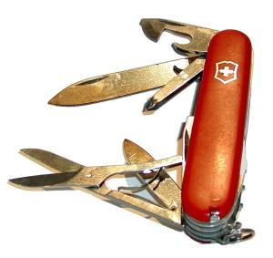
Why the funny name of Jackknife?
Jackknife: a pocket knife http://en.wikipedia.org/wiki/Jackknife
Mosteller and Tukey (1977, p. 133) described a predecessor resampling method, the jackknife, in the following way:
“The name ‘jackknife’ is intended to suggest the broad usefulness of a technique as a substitute for specialized tools that may not be available, just as the Boy Scout’s trustworthy tool serves so variedly…”
http://mrw.interscience.wiley.com/emrw/9780470013199/esbs/article/bsa321/current/abstract

Slide 4


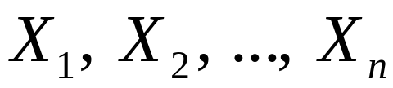



Illustration of Jackknife
Population,
Estimate by
sampling
inference
resampling
N times
statistics

Slide 5
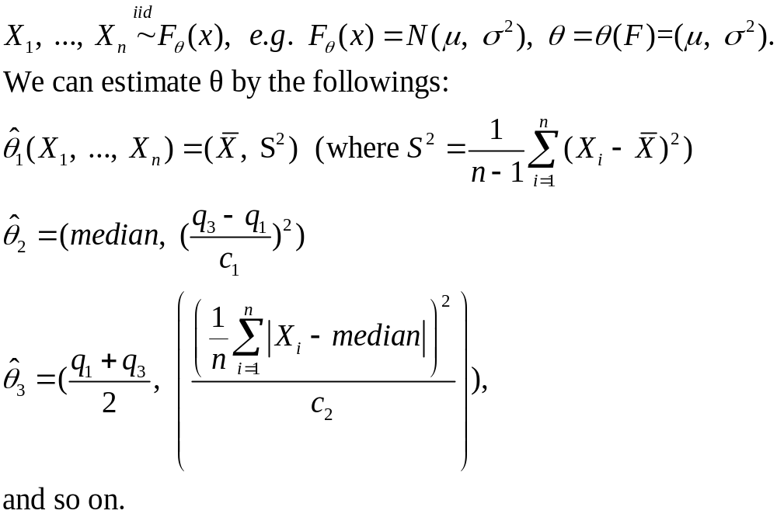
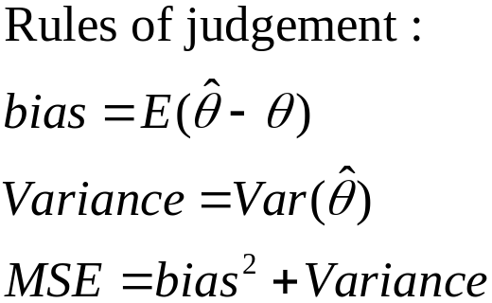
Math Expression

Slide 6
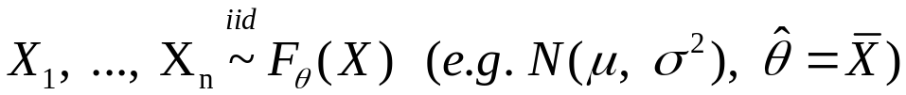
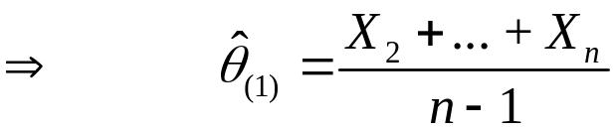

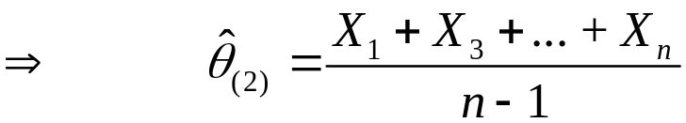
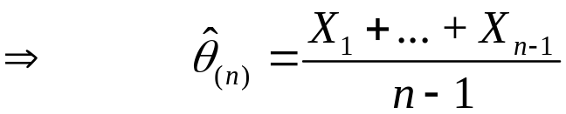
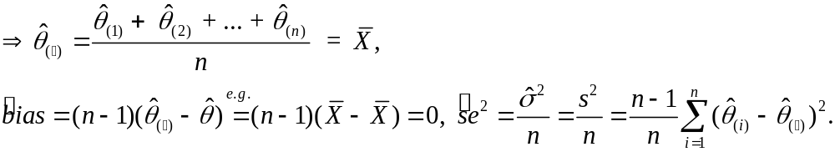
An Example of Jackknife (1)
HW
HW

Slide 7
An Example of Jackknife (2)

Slide 8
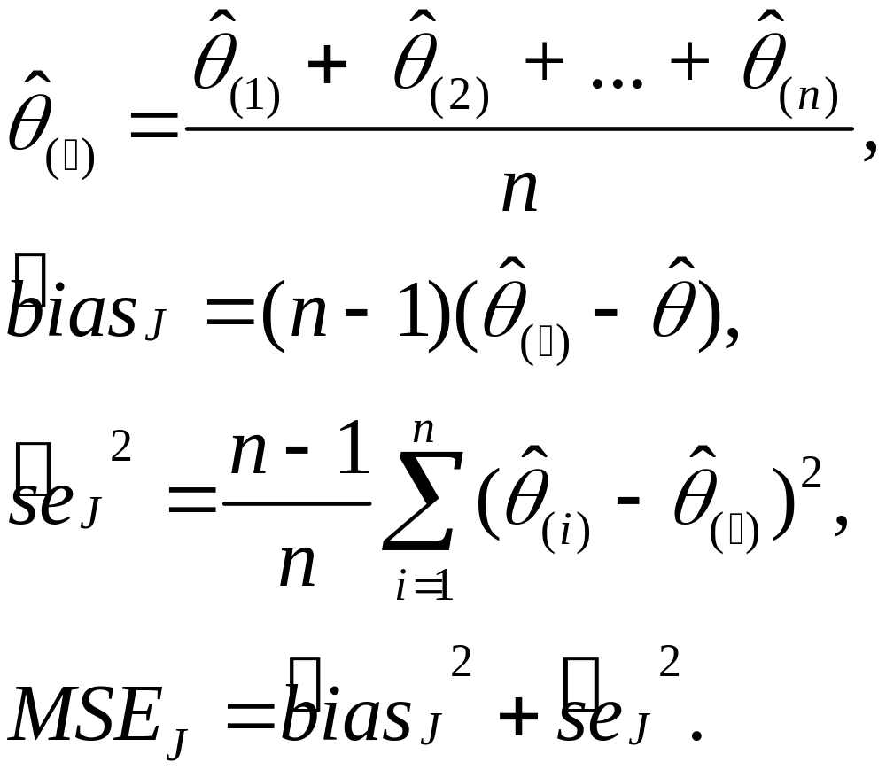
Summary of the Jackknife Method

Slide 9
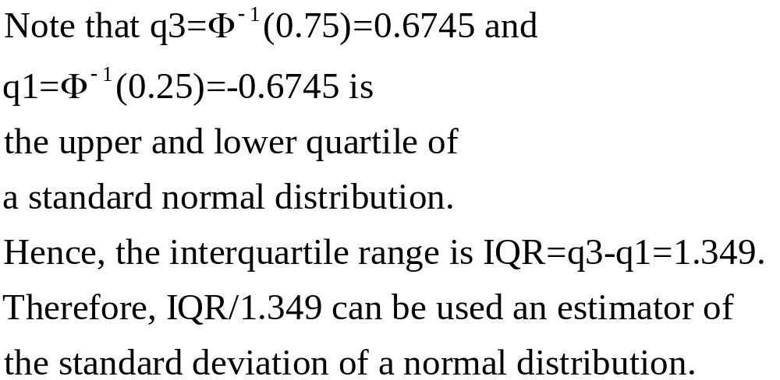
How do quartiles lead to an estimate?

Slide 10
PART 2: Bootstrap
Naming
Illustration
Math Expression
Examples
R codes
  Three approaches
    Package(bootstrap)
    Package(boot)
    Write your own R codes
C codes

Slide 11
The Bootstrap
Bootstrap technique was proposed by Bradley Efron (1979, 1981, 1982) in literature.
Bootstrapping is an application of intensive computing to traditional inferential methods.

Slide 12
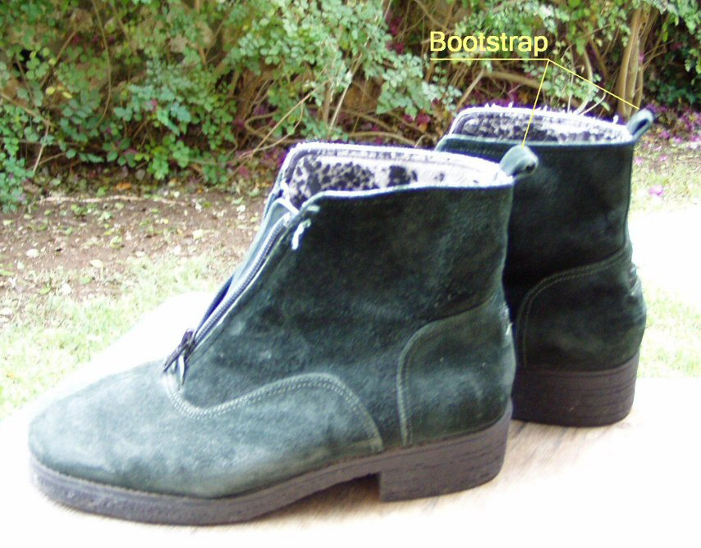
Why the funny name of bootstrap?
Bootstrap: http://www.concurringopinions.com/archives/Bootstrap_1.jpg
In the book of ‘Singular Travels, Campaigns and Adventures of Baron Munchausen’ by R. E. Raspe (1786), the main character, finding himself in a deep hole, extracts himself using only the straps of his boots.
http://tigger.uic.edu/~slsclove/stathumr.htm

Slide 13

Illustration of Bootstrap
Population,
estimate by
sampling
inference
resampling
B times
statistics

Slide 14
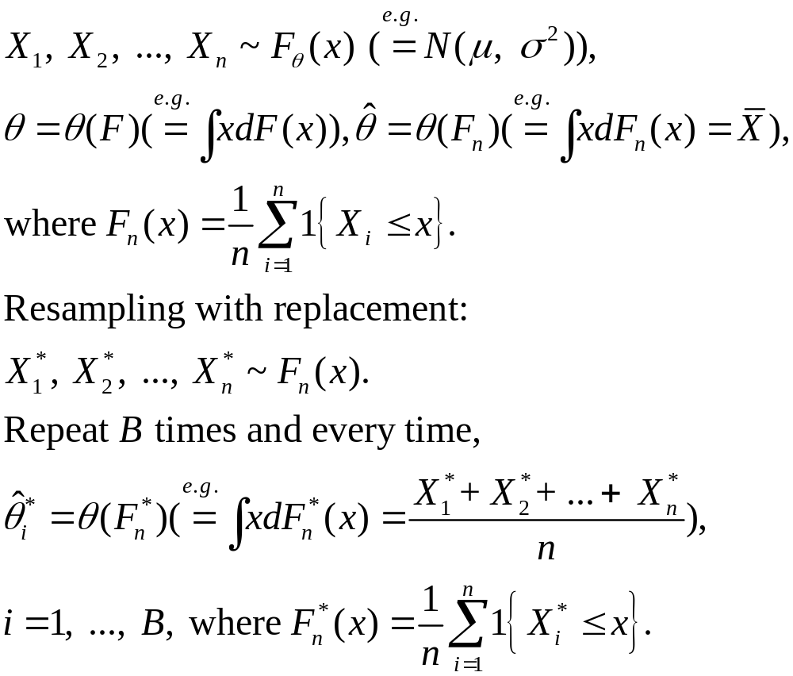
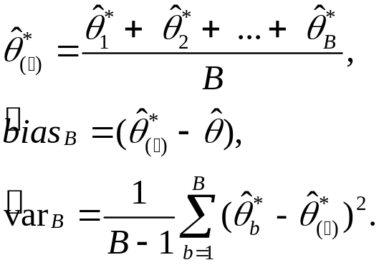
Math Expression

Slide 15
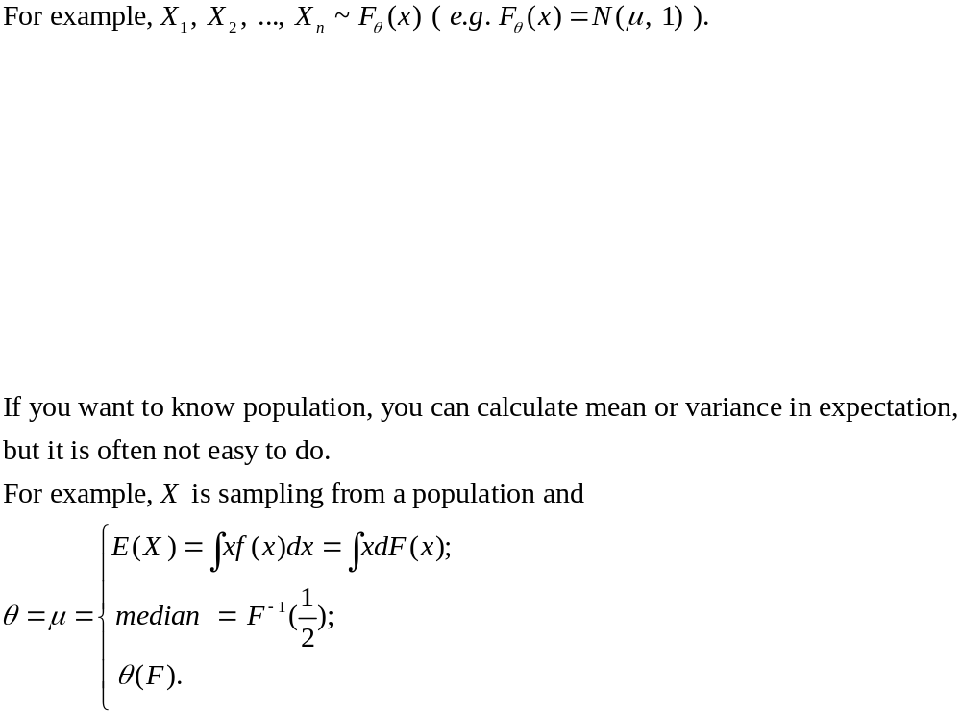
Population,

Slide 16
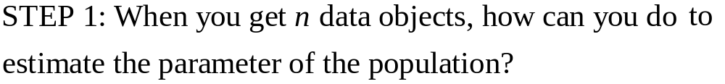
Population
step1
sampling

Slide 17
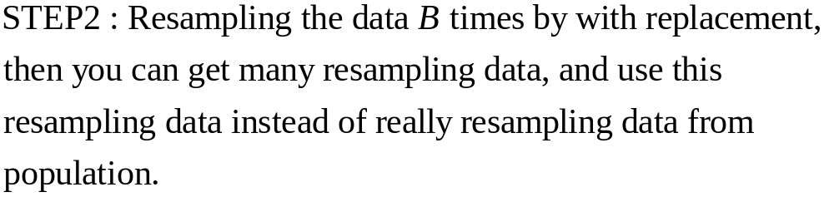
step2
resampling
B times

Slide 18
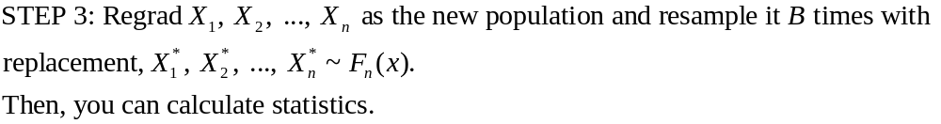
Step 3:
statistics

Slide 19
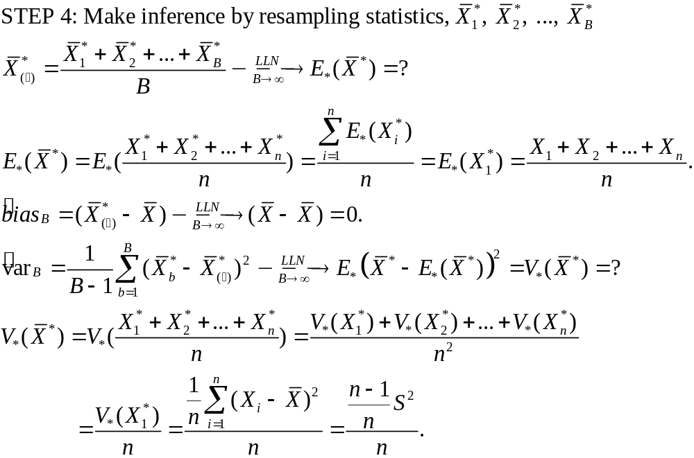

Slide 20
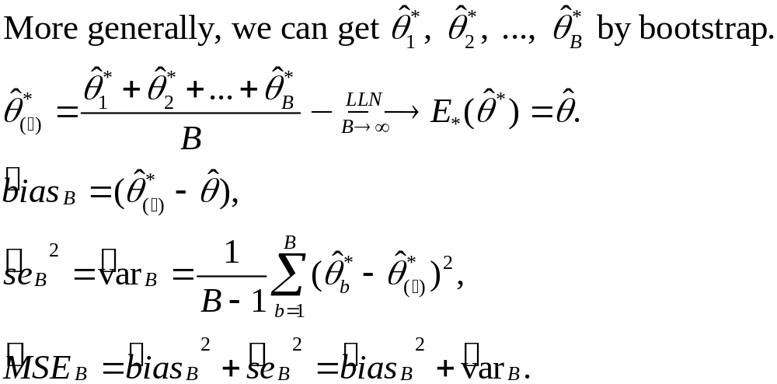
Summary of the Bootstrap Method

